Slide 1
Decision trees…
Made by:
RIMSHA TARIQ
21-ARID-661

Slide 2
INTRODUCTION…
A decision tree is a decision support tool that uses a tree-like model of decisions.
A decision tree is a very specific type of probability tree that enables you to make a decision about some kind of process.
A decision tree is a graphical representation of possible solutions.
It starts from single part or root and then divides into a number of solutions just like a tree.
Decision trees are helpful not only for they are graphically represented but also because making a decision tree requires a systematic(a way that is done according to the set of methods), documented thought process.

Slide 3
Introduction…
It is one way to display an algorithm that only contains conditional control statements.
A decision tree is a graph that uses a branching method to illustrate every possible output for a specific input.
Decision trees can be drawn by hand or created with a graphics program or specialized software.
Decision trees are useful for focusing discussion when a group must make a decision.

Slide 4
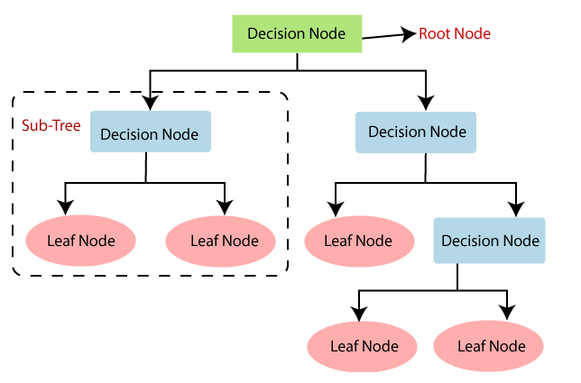
General structure…
Note: A decision tree can contain categorical data (YES/NO) as well as numeric data.

Slide 5
Decision Tree Terminologies…
Root Node
Leaf Node
Splitting
Branch/Sub Tree
Pruning
Parent/Child node

Slide 6
Terminologies…
Root node is from where the decision tree starts. It represents the entire dataset, which further gets divided into two or more homogeneous sets.
Leaf nodes are the final output node, and the tree cannot be segregated further after getting a leaf node.
Splitting is the process of dividing the decision node/root node into sub-nodes according to the given conditions.
A sub tree is a tree formed by splitting the tree.
Pruning is the process of removing the unwanted branches from the tree.
The root node of the tree is called the parent node, and other nodes are called the child nodes.

Slide 7
Purpose…
Decision trees are extremely useful for data analytics and machine learning.
They break down complex data into more manageable parts.
They're often used in these fields for prediction analysis, data classification, and regression.

Slide 8
Rules…
Decision trees work by recursively partitioning the data based on input field values. The data partitions are called branches. The initial branch (sometimes called the root) encompasses all data records. The root is split into subsets, or child branches, based on the value of a particular input field. Each child branch can be further split into sub-branches, which can in turn be split again, and so on. At the lowest level of the tree are branches that have no more splits. Such branches are known as terminal branches (or leaves).

Slide 9
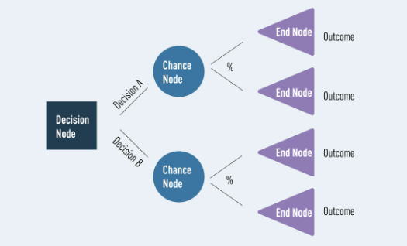
FACTORS…
Decision trees are composed of three main parts
Decision nodes (denoting choice)
Chance nodes (denoting probability)
End nodes (denoting outcomes).

Slide 10
Advantages…
It is simple to understand as it follows the same process which a human follow while making any decision in real-life.
It can be very useful for solving decision-related problems.
It helps to think about all the possible outcomes for a problem.
There is less requirement of data cleaning compared to other algorithms.

Slide 11
Disadvantages…
The decision tree contains lots of layers, which makes it complex.
It may have an overfitting issue, which can be resolved using the Random Forest algorithm.
For more class labels, the computational complexity of the decision tree may increase.

Slide 12
Example…
Suppose there is a candidate who has a job offer and wants to decide whether he should accept the offer or Not. So, to solve this problem, the decision tree starts with the root node (Salary attribute by ASM). The root node splits further into the next decision node (distance from the office) and one leaf node based on the corresponding labels. The next decision node further gets split into one decision node (Cab facility) and one leaf node. Finally, the decision node splits into two leaf nodes (Accepted offers and Declined offer).

Slide 13
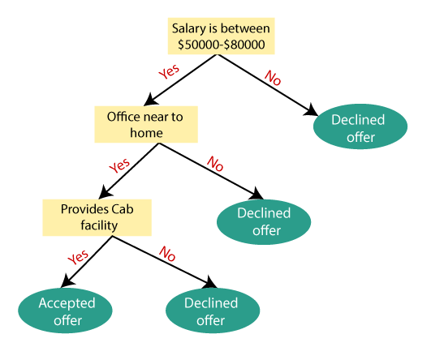
Diagram…

Slide 14
Data Mining Classification
Made by:
MARIA SHAKEEL
21-ARID-593

Slide 15
Supervised learning
Supervised learning refers to problems where the value of a target attribute should be predicted based on the values of other attributes.
For example: Train machine that identify the image of animal . Machine Learning model to recognize if the image is of a cat or a dog.
Problems with a categorical target attribute are called classification, problems with a numerical target attribute are called regression.
For example, we can use regression to predict the price of a house.

Slide 16
Classification: Definition
Given a collection of records (training set ) – Each record contains a set of attributes, one of the attributes is the class.
Find a model for class attribute as a function of the values of other attributes.
A test set is used to determine the accuracy of the model. Usually, the given data set is divided into training and test sets, with training set used to build the model and test set used to validate it.

Slide 17
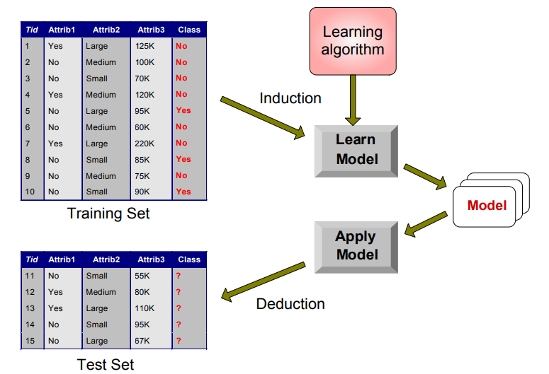
Illustrating Classification Task

Slide 18
Classification Techniques
Decision Tree based Methods
Rule-based Methods
Memory based reasoning
Neural Networks
Naïve Bayes and Bayesian Belief Networks
Support Vector Machines

Slide 19

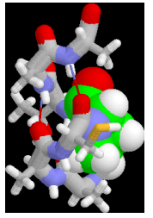
Examples of Classification Task
Predicting tumor cells as benign or malignant.
Classifying credit card transactions as
legitimate or fraudulent.
Classifying secondary structures of protein as
alpha-helix, beta-sheet, or random coil.
Categorizing news stories as finance,
weather, entertainment, sports etc.

Slide 20
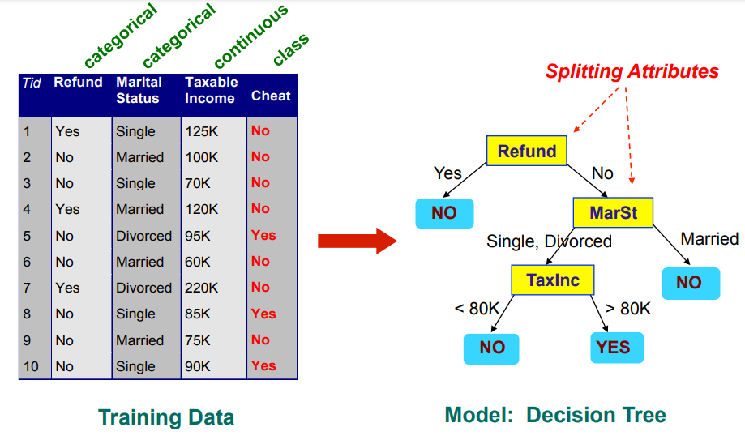
Example of a Decision Tree

Slide 21
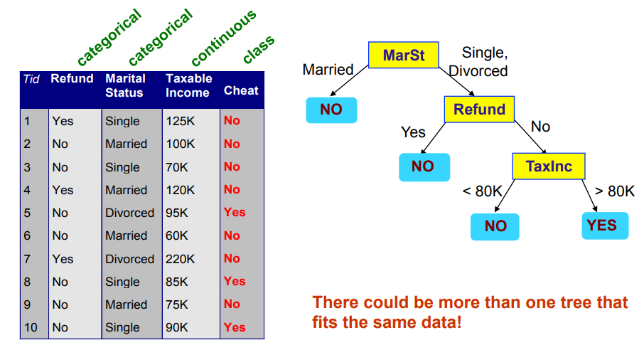
Another Example of Decision Tree

Slide 22
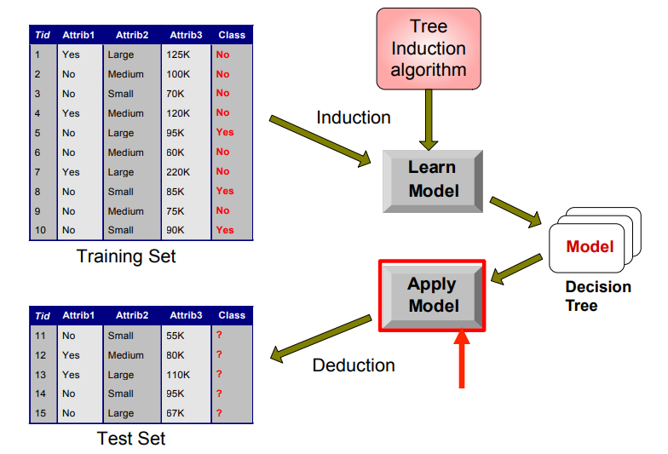
Decision Tree Classification Task

Slide 23
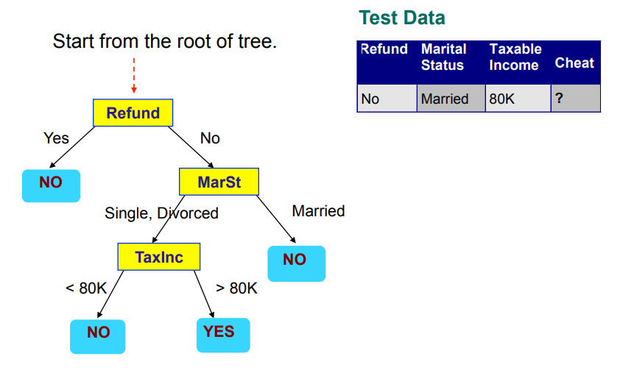
Apply Model to Test Data

Slide 24
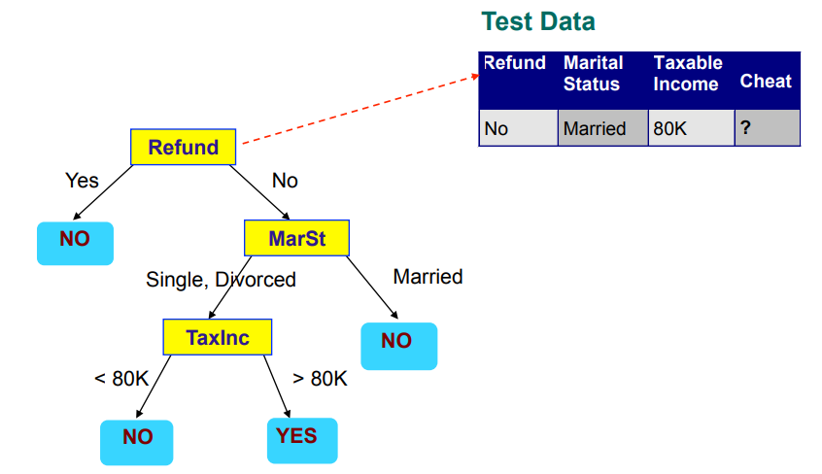
Apply Model to Test Data

Slide 25
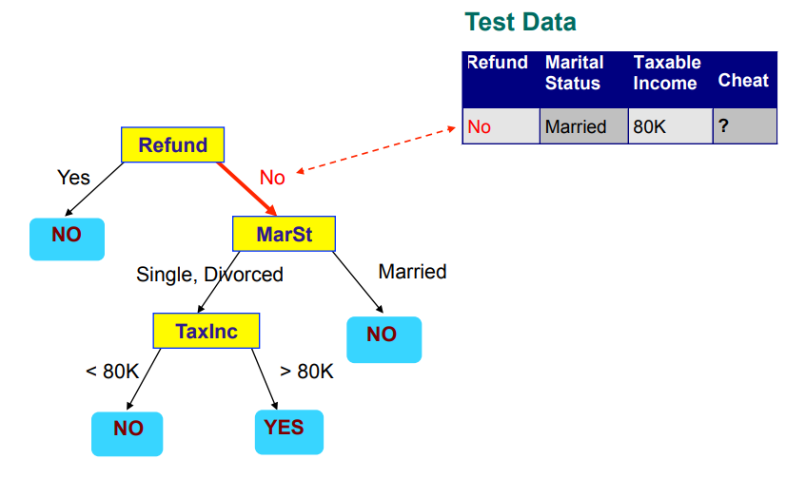
Apply Model to Test Data

Slide 26
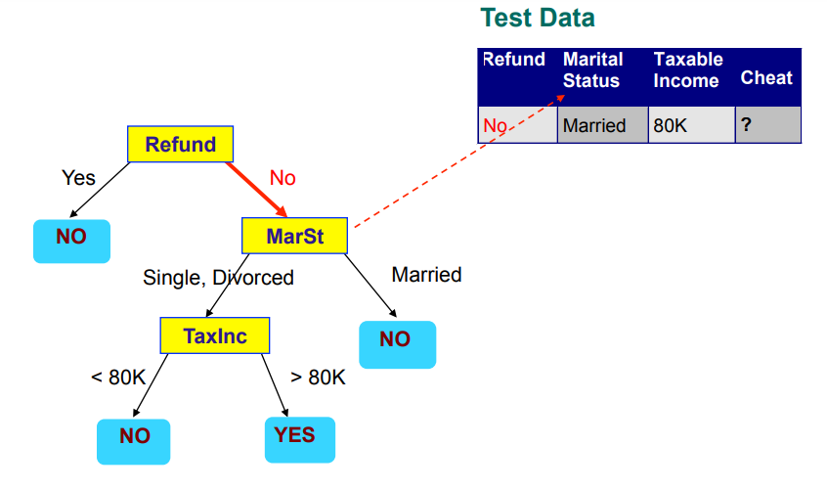
Apply Model to Test Data

Slide 27
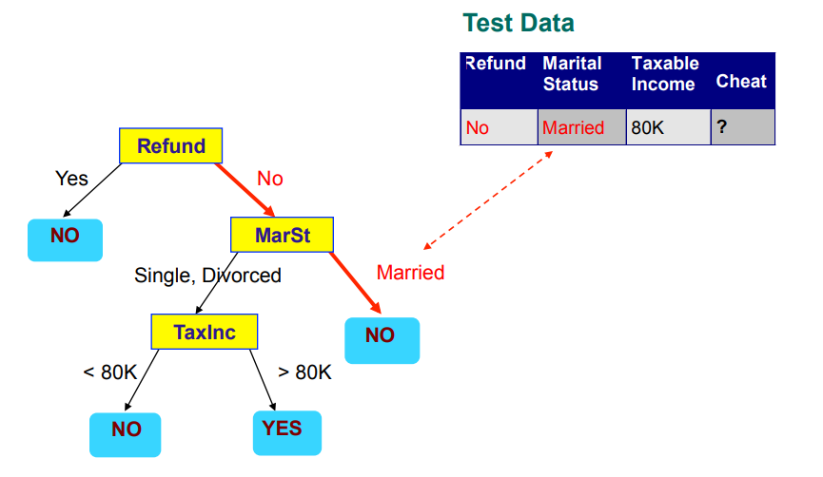
Apply Model to Test Data

Slide 28
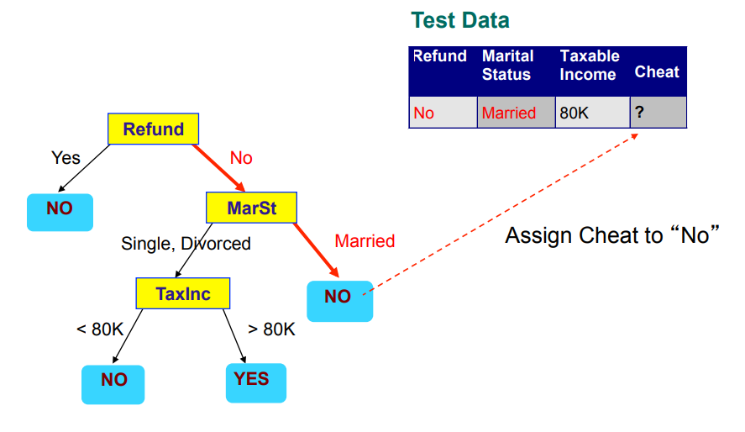
Apply Model to Test Data

Slide 29
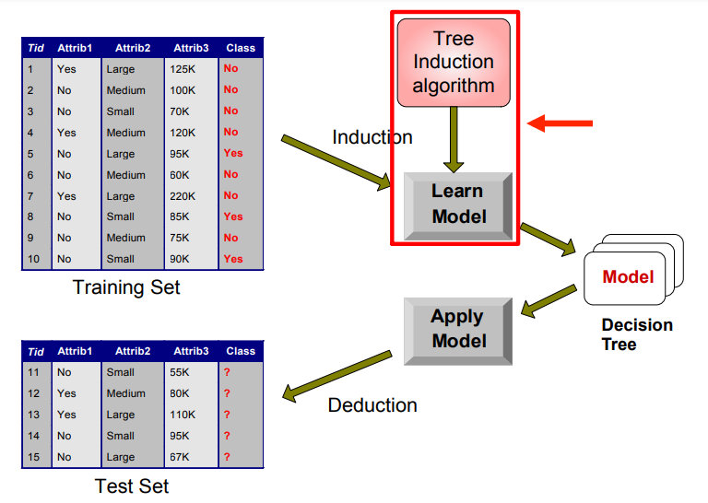
Decision Tree Classification Task

Slide 30
Tree Induction
Greedy strategy.
Split the records based on an attribute test that optimizes certain criterion.
Issues
Determine how to split the records
How to specify the attribute test condition?
How to determine the best split?
Determine when to stop splitting

Slide 31
How to Specify Test Condition?
Depends on attribute types
Nominal
Ordinal
Continuous
Depends on number of ways to split
2-way split
Multi-way split

Slide 32


Splitting Based on Nominal Attributes
Multi-way split: Use as many partitions as distinct values.
Binary split: Divides values into two subsets. Need to find optimal partitioning.

Slide 33



Splitting Based on Ordinal Attributes
Multi-way split: Use as many partitions as distinct values.
Binary split: Divides values into two subsets. Need to find optimal partitioning.
What about this split?

Slide 34
Splitting Based on Continuous Attributes
Different ways of handling
Discretization to form an ordinal categorical attribute
Static – discretize once at the beginning
Dynamic – ranges can be found by equal interval bucketing, equal frequency bucketing (percentiles), or clustering.
Binary Decision: (A < v) or (A ≥ v)
consider all possible splits and finds the best cut
can be more compute intensive

Slide 35
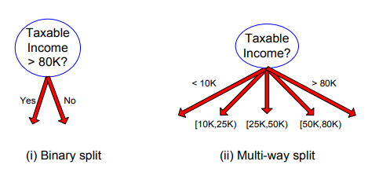
Splitting Based on Continuous Attributes

Slide 36
ALGORITHM
Made by:
SIDRA-TUL-MUNTAHA SATTAR
21-ARID-672

Slide 37
Algorithm
STEPS:
It begins with the original set S as the root node.
On each iteration of the algorithm, it iterates through the very unused attribute of the set S and calculates Entropy(H) and Information gain(IG) of this attribute.
It then selects the attribute which has the smallest Entropy or Largest Information gain.
The set S is then split by the selected attribute to produce a subset of the data.
The algorithm continues to recur on each subset, considering only attributes never selected before.

Slide 38
Attribute Selection Measures
For solving this attribute selection problem, researchers worked and devised some solutions. They suggested using some criteria like :
Entropy,
Information gain,
Gini index,

Slide 39
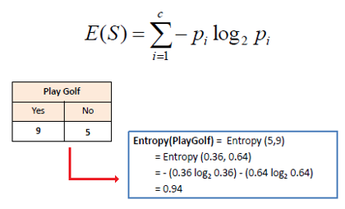
Entropy
Entropy is a measure of the randomness in the information being processed. The higher the entropy, the harder it is to draw any conclusions from that information.

Slide 40
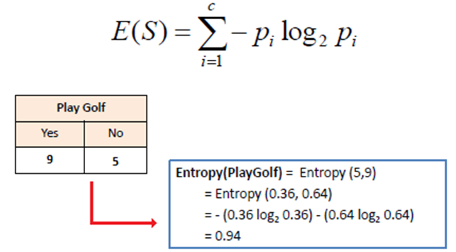


Slide 41
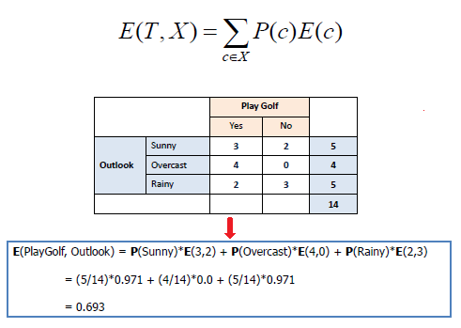
Mathematically Entropy for multiple attributes is represented AS:

Slide 42
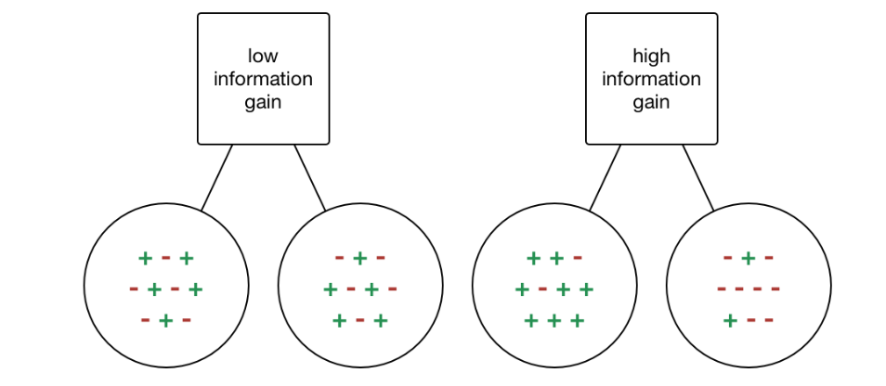
Information Gain
Information gain or IG is a statistical property that measures how well a given attribute separates the training examples according to their target classification. Constructing a decision tree is all about finding an attribute that returns the highest information gain and the smallest entropy.

Slide 43
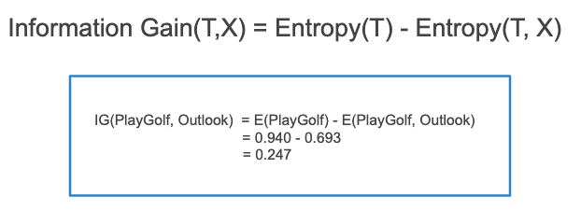
Mathematically, IG is represented as:

Slide 44

In a much simpler way, we can conclude that:

Slide 45
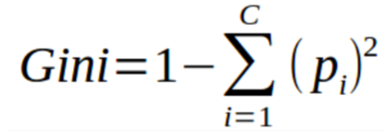
Gini Index
You can understand the Gini index as a cost function used to evaluate splits in the dataset. It is calculated by subtracting the sum of the squared probabilities of each class from one.
Higher value of Gini index implies higher inequality, higher heterogeneity.

Slide 46
Steps to Calculate Gini index for a split
Calculate Gini for sub-nodes, using the above formula for success(p) and failure(q) (p²+q²).
Calculate the Gini index for split using the weighted Gini score of each node of that split.
CART (Classification and Regression Tree) uses the Gini index method to create split points.

Slide 47
Conclusion
Gini Index is a powerful measure of the randomness or the impurity or entropy in the values of a dataset.
Gini Index aims to decrease the impurities from the root nodes (at the top of decision tree) to the leaf nodes (vertical branches down the decision tree) of a decision tree model

Slide 48
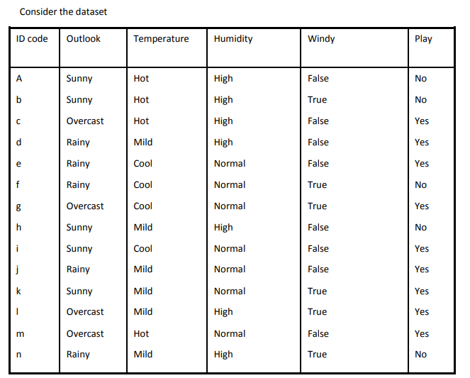
Decision Tree Model

Slide 49
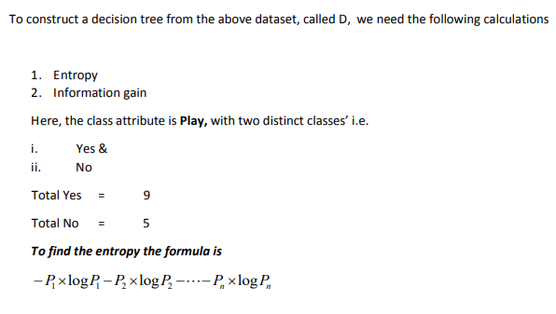

Slide 50
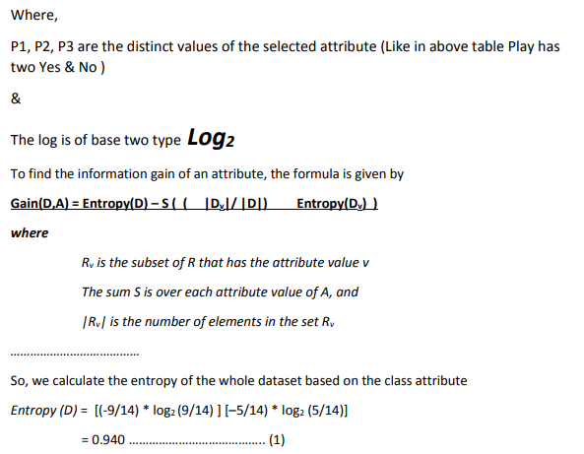

Slide 51
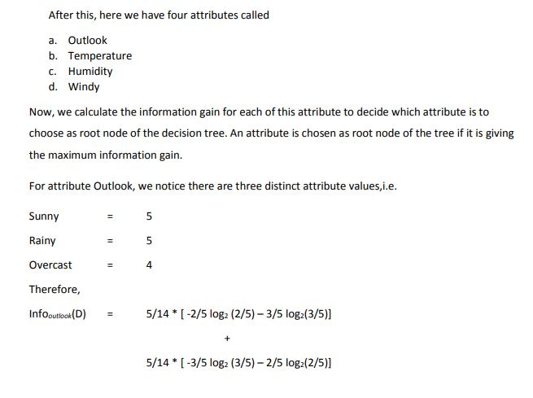

Slide 52
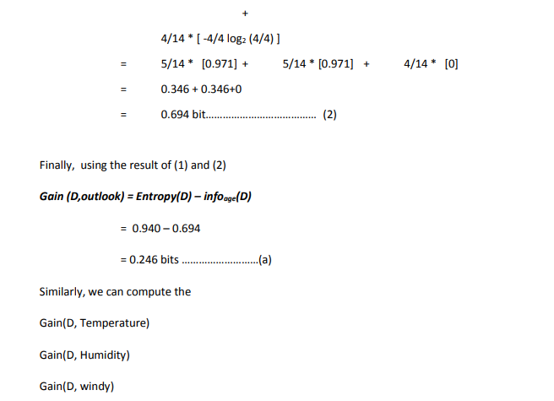

Slide 53
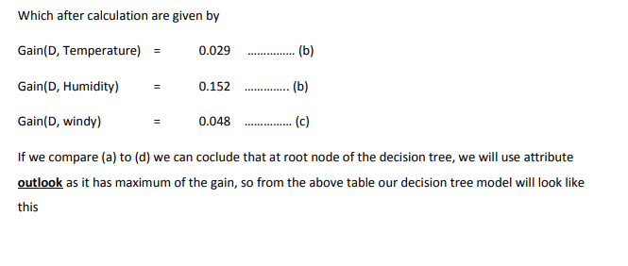

Slide 54
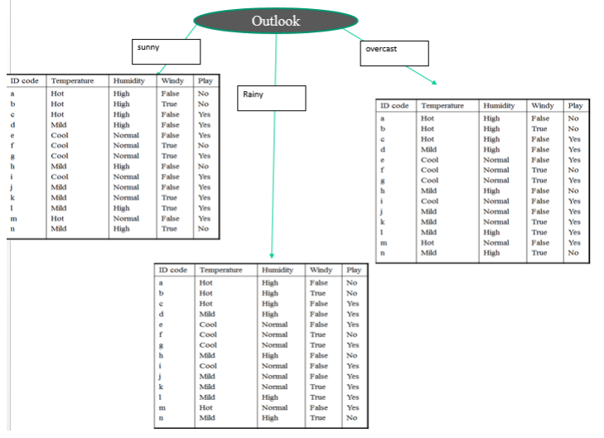

Slide 55
summary…
Let’s summarize:
Decision trees are composed of three main parts—decision nodes (denoting choice), chance nodes (denoting probability), and end nodes (denoting outcomes).
Decision trees can be used to deal with complex datasets, and can be pruned if necessary to avoid overfitting.
Despite having many benefits, decision trees are not suited to all types of data, e.g. continuous variables or imbalanced datasets.
They are popular in data analytics and machine learning, with practical applications across sectors from health, to finance, and technology.

Slide 56
THANK YOU…..!!!!

